Slide 1
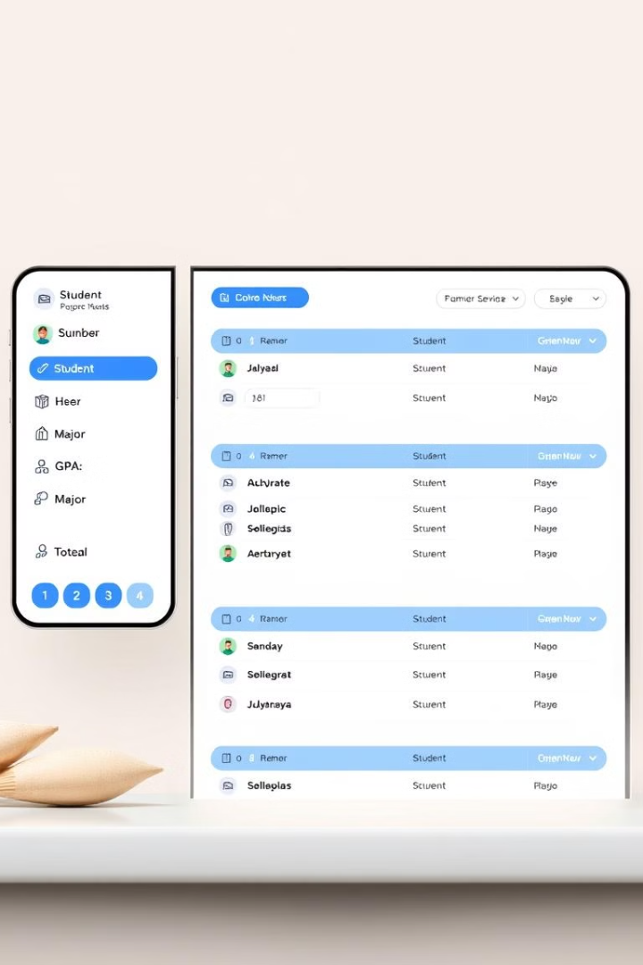

STUDENT DATABASE MANAGEMENT SYSTEM
This presentation provides an overview of a Student Database Management System developed by the team of [THOUFEEQ-231801182], [UDHAYANIDHI-231801186], and [VIDHURSH KUMAR-231801186].
by VIDHURSH KUMAR V 231801186

Slide 2
Abstract
Python
MongoDB
Java
The system is built using the Python programming language, known for its simplicity and versatility.
The database component utilizes MongoDB, a popular NoSQL database, to handle the student data efficiently.
Java is used for the backend processes and integration, providing a robust and scalable foundation.

Slide 3

Survey of Technologies
1
Software Description
2
Programming Languages
3
Database Integration
The system encompasses features for student registration, course management, grade tracking, and reporting.
The core languages used are SQL for database queries and Python for application logic.
MongoDB is integrated to provide a flexible and scalable data storage solution.

Slide 4
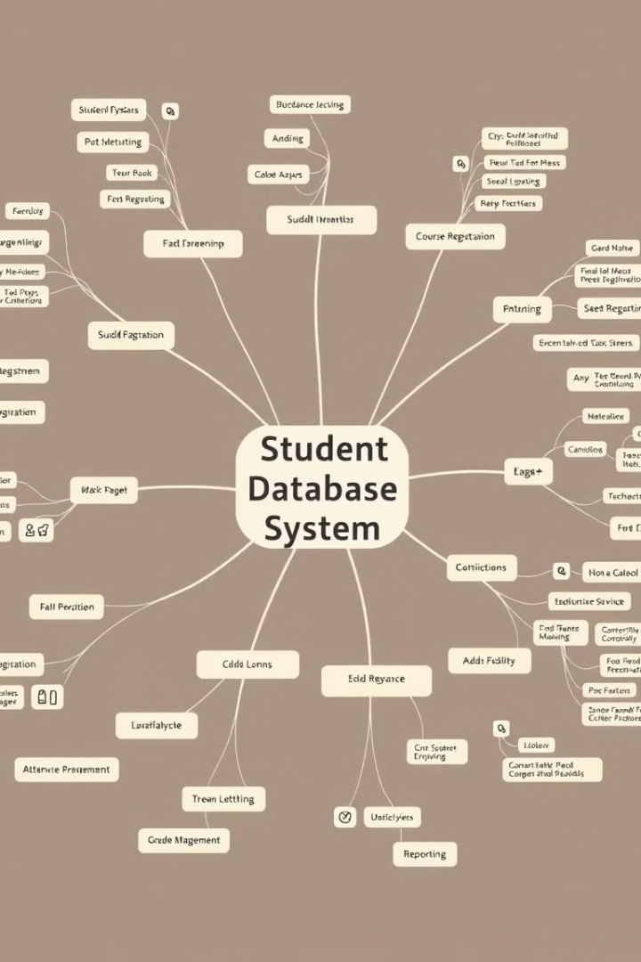
Student Database Mind Map
1
Student Registration
Allows students to create accounts and manage their personal information.
2
Course Enrollment
Enables students to enroll in courses and view their schedules.
3
Grade Tracking
Provides a centralized platform to record and track student grades and performance.

Slide 5

Languages
SQL
Python
Structured Query Language is used for database management and data manipulation.
The Python programming language is utilized for the application logic and backend development.

Slide 6
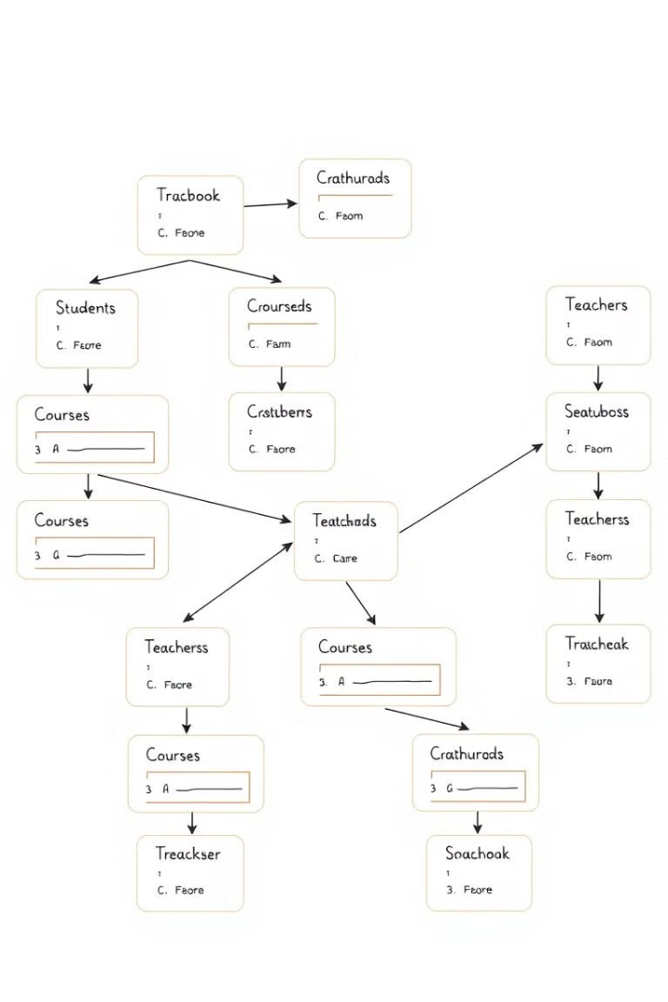



SQL
Database
Utilizes SQL for managing the relational database that stores student data.
Queries
Employs SQL queries for efficient data retrieval, insertion, and manipulation.
Schema
Defines the structure and relationships of the student database tables.

Slide 7




Python
Application Logic
Python is used to implement the core functionality of the student management system.
Data Processing
Python scripts handle data manipulation, analysis, and report generation.
Integration
Python enables seamless integration with the MongoDB database and other system components.

Slide 8

Conclusion
Robust Solution
Scalable and Flexible
The student database management system provides a comprehensive and reliable solution for educational institutions.
The system's modular design and use of cutting-edge technologies ensure scalability and adaptability to future needs.

Slide 9




Thank You
Collaboration
Innovation
Future Prospects
The project was a collaborative effort between the team members, demonstrating strong teamwork and dedication.
The system incorporates innovative approaches and leverages the latest technologies to enhance student data management.
The system is poised to make a significant impact on the educational landscape, benefiting students and institutions alike.

